Slide 1
Computer Organization and Assembly Fall 2019
Lecture 3
Syeda Farwa Batool

Slide 2
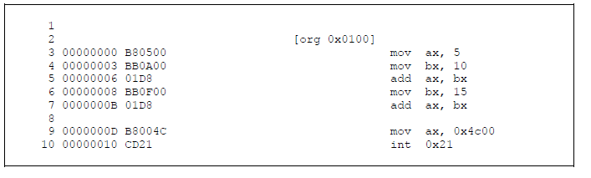
Reading Listing File
Size of program is = 3 + 3 + 2 + 3 + 2 + 3 + 2 = 18 bytes = > 12 in hex, CX register will has 12

Slide 3
Segmented Memory
Memory model
How memory is represented to processor and processor looks at memory is called memory model
Linear memory model
Memory is like an array any In linear memory model we can keep and retrieve data from and to anywhere, 8080 and 8085 has 64kb total memory 16 bit addressing and it has linear memory model.
Segmented Memory
When intel moves from 8085 to 8088 they introduced 1MB memory, So to make 8085 program compatible in 8088 (downward compatible) they came up with an idea. Created 3 logical/functional parts (windows) of a program.
data code and stack

Slide 4
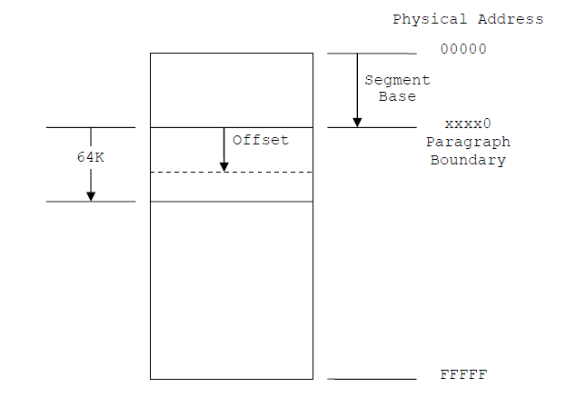
These logical sections are called segments.
Basically there are three functional segments/windows of memory (code segment, data segment and stack segment) and one extra segment
Maximum size of a each segment or window is 64 kb
Whole memory size is 1MB (we have seen that we have 20 address bits)
now we can slide this widow any where but any moment 4 windows exist
now we need reference to any segment, so each segment register has base point or starting point of that segment with reference of 0 physical address.

Slide 5
Cont.
Offset
After identifying segment we need to know which instruction of segment we have to execute, for example Code segment has starting address of code section but which instruction we have to execute this information is saved in IP register. So IP register value will be called offset.
IP
BX
DI
SI
SP
Each offset is by default associated to some segment register, for example IP is associated with CS
CS:IP
DS:BX
ES:DI
DS:SI
SS:SP

Slide 6
Address calculation
We have seen size of address bus which is 20 bits,
But
Segment register size is 16 bit
Offset bit register size is 16 bit
So how we will make a 20 bit address to access any memory location of a 1MB memory which is divided into 4 segments.

Slide 7
Cont.
This is our 20 bit address which we need to prepare
19 15 0
Now we shift 4 bits left of segment register address
19 3 0
Segment register address
 |  |  |  | - | - | - | - | - | - | - | - | - | - | - | - | - | - | - | -
Sifted Segment register address
- | - | - | - | - | - | - | - | - | - | - | - | - | - | - | 0 | 0 | 0 | 0

Slide 8
Cont.
19 3 0
19 15 0
Sifted Segment register address
- | - | - | - | - | - | - | - | - | - | - | - | - | - | - | 0 | 0 | 0 | 0
offset register address
0 | 0 | 0 | 0 | - | - | - | - | - | - | - | - | - | - | - | - | - | - | - | -

Slide 9
Example
We have seen in our previous code that IP for first instruction was 0100 and CS value is 19F5
Now we need to compute Physical address (exact memory location of instruction in 1 MB memory)
CS = 0x19F5
Shifted CS = 0x19F50
IP = 0x0100
Physical address = 0x19F50 + 0x0100 = 1A050
If any carry is generated it will be ignored, this is called segment wraparound

Slide 10
Overlapping Segments
Different logical address can make same physical address.
For example
Physical address = 19F50 + 0100 = 1A050
Physical address = 1A050 + 0000 = 1A050
Physical address = 19E50 + 0200 = 1A050
If value of each segment is same then these segments are overlapping.

Slide 11
Paragraph Boundaries
The address of first segment last zero is fix, we cant change it. And it is also invisible.
0x0000
Now address of second segment can be
0x0010 => 128 bits means we have 16 byte boundary
1st segment address is 0x000
16 bytes
0000 0000 000 0001 0000
2nd segment address is 0x001

